Slide 1

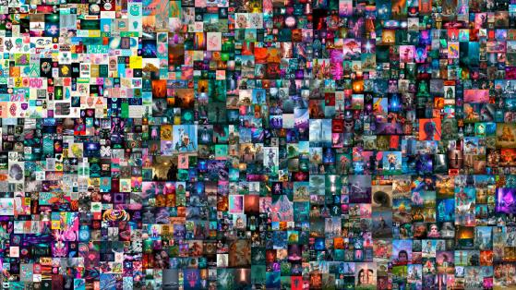
NFT
Own your Asset

Slide 2
Contents
Overview - Definition - Market
Comparo - NFT vs FT
Standards - ETH vs EOS
Applications - Categories - Expensive NFTs sold

Slide 3
Overview

Slide 4




Definition
Non-fungible tokens (NFTs), also often referred to as “crypto collectibles” or “digital assets”.
Fungibility: the ability of an asset to be exchanged or substituted with similar assets of the same value.

Slide 5
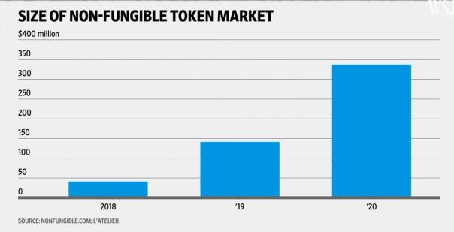
Market
NFTs are one of the key building blocks of a new, blockchain-powered digital economy.

Slide 6
Comparo

Slide 7

NFT vs FT
Unlike cryptocurrencies, where all tokens are created equally, non-fungible tokens are each unique and limited in quantity.

Slide 8
Standards

Slide 9


ETH
EOS
ERC-721
ERC-1155
SimpleAssets
AtomicAssets
DGoods

Slide 10
Applications

Slide 11
Categories
Cards are currently only being used as collectibles.
House property can be built as a NFT whose ownership can’t be altered w/o prior permission unlike today’s situation.
Music piracy is all over. So, the copyrights can be preserved.
Non-digital/digital paintings can be uniquely owned.

Slide 12

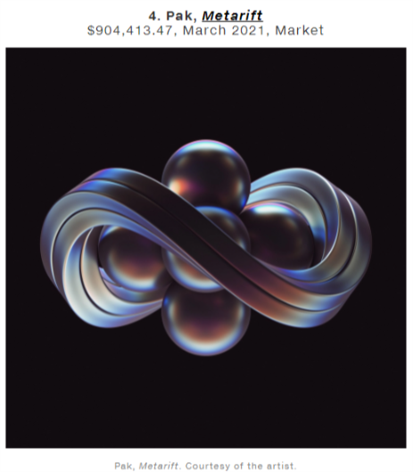
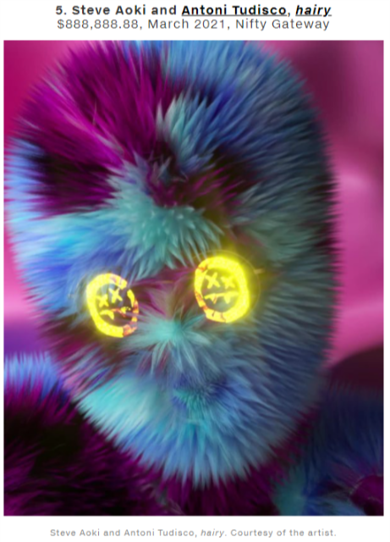
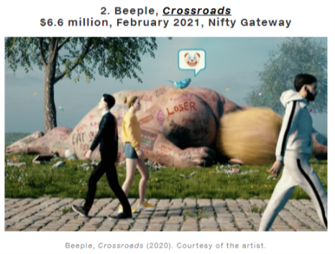
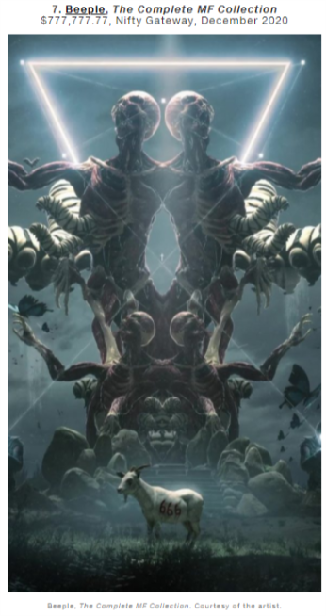
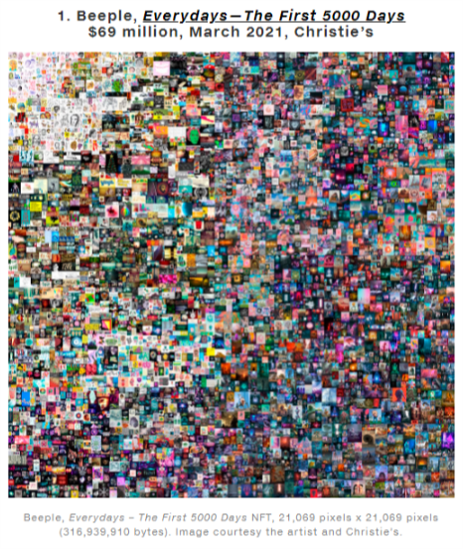
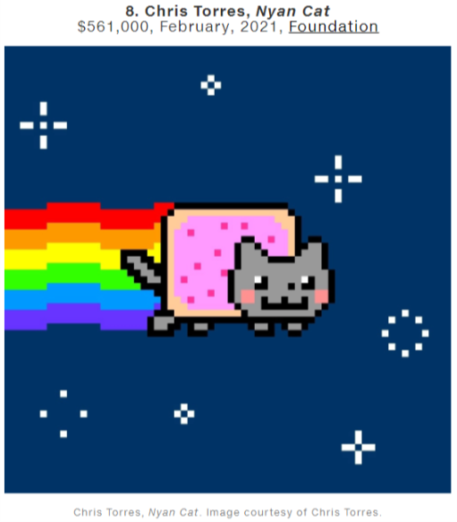
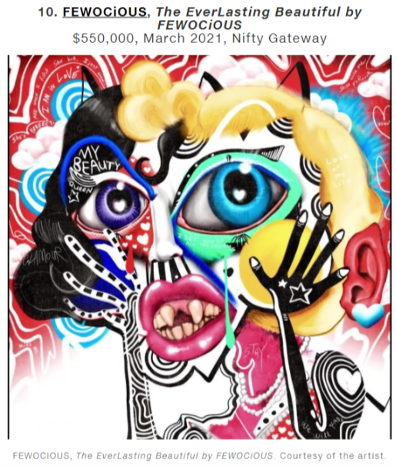
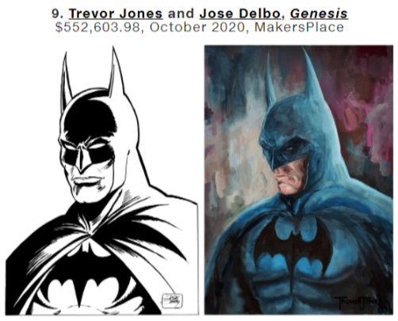
Expensive NFTs sold
Source

Slide 13
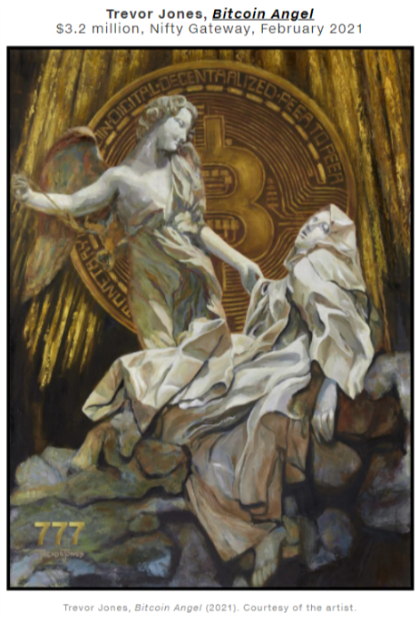
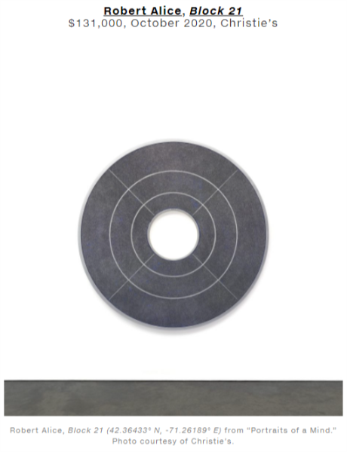
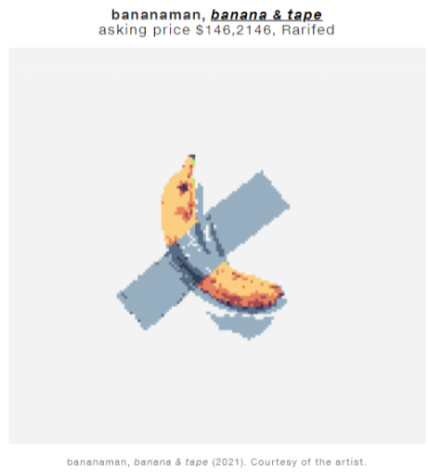
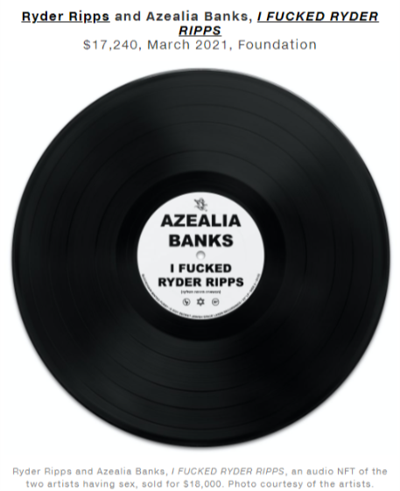


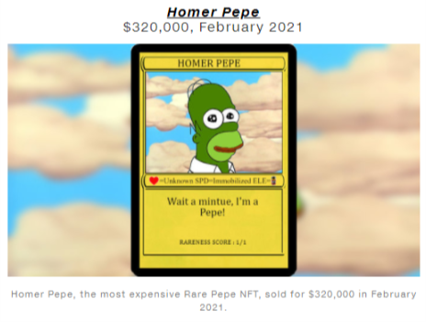
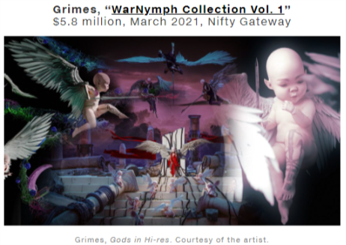
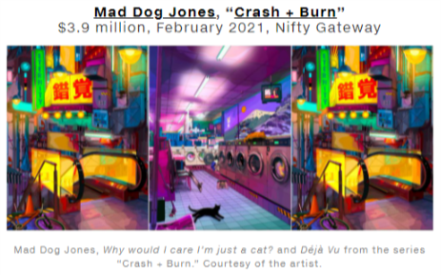
Other NOTABLE NFT ART
Source

Slide 14
Problems
The big NFTs marketplaces like Opensea, Nifty Gateway, Makersplace, etc. use Ethereum Blockchain taking high transaction fees for listing NFTs on sale/auction, for buying NFTs.
Each NFT when deposited is costly for the environment. The real-world energy used to process a single Ethereum transaction is equivalent to the average EU resident’s electricity consumption for four days. It’s a huge drain on the environment. And for users, this can mean expensive ‘gas fees’ – a complex costs system where buyers and sellers pay for the energy use of processing blockchain transactions.

Slide 15

THANKS

